Slide 1
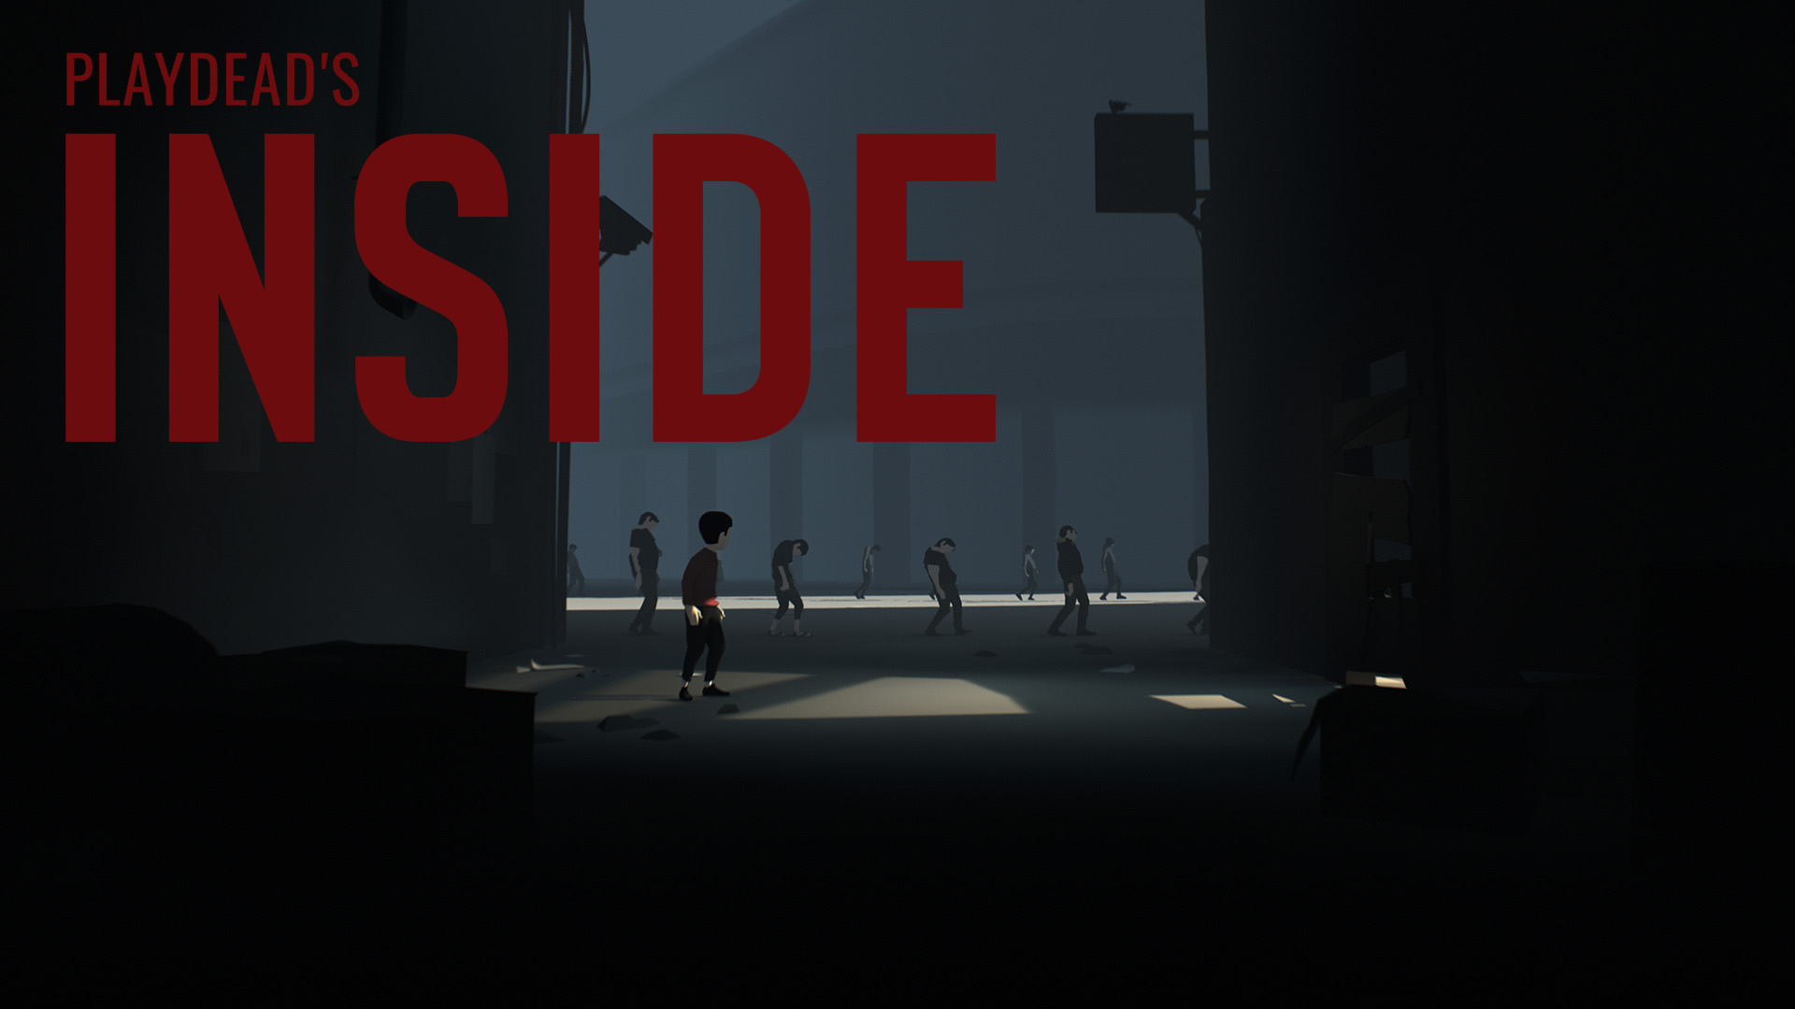
Notes:
I am going to cover Inside that was developed by Playdead. Inside is a 2.5D puzzle platformer that was developed over the course of 6 years by over 25 developers.
1

Slide 2
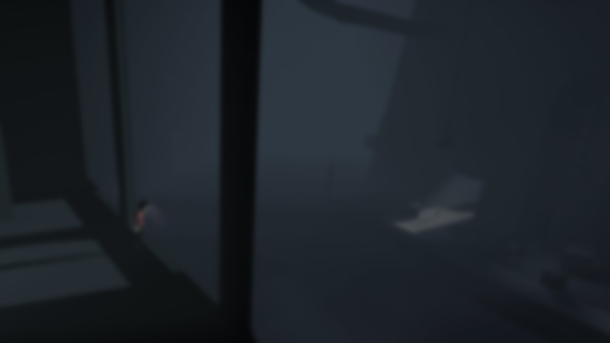

UNITY 5
PROS
Visual editing tools.
Support a wide array of platforms.
High quality product with low complexity.
CONS
Pour implementation of source control and collaboration tools.
Prefab nesting difficulties.
Asynchronous content streaming.
Notes:
Inside was developed in Unity 5 due to two main reasons according to developers.
Firstly, they wanted to publish the game on PC PS4 and Xbox One.
Secondly,They wanted to achieve exceptional aesthetical quality and gameplay performance without making overly complex systems.
However, unity also has its downfalls that Developers at Playdead overcame by customising unity through editing source code and by designing the game around the downfall of the engine.
Now I will go into more detail of how unity deals with physics and rendering pipeline in the context of Inside.
2

Slide 3

NVIDIA PHYSX 3.3
3D Colliders.
3D Rigid bodies.
Raycasting.
No hardware acceleration.
Notes:
Inside uses Nvidia PhysX 3.3 to process all physics calculations e.g. 3D collisions, 3D rigid bodies and raycasting. This is because, Unity uses Nvidia PhysX SDK , though only as a software processor. Nvidia PhysX could be used for liquid and destruction simulation though that would require hardware acceleration that is not supported by Unity.
3

Slide 4

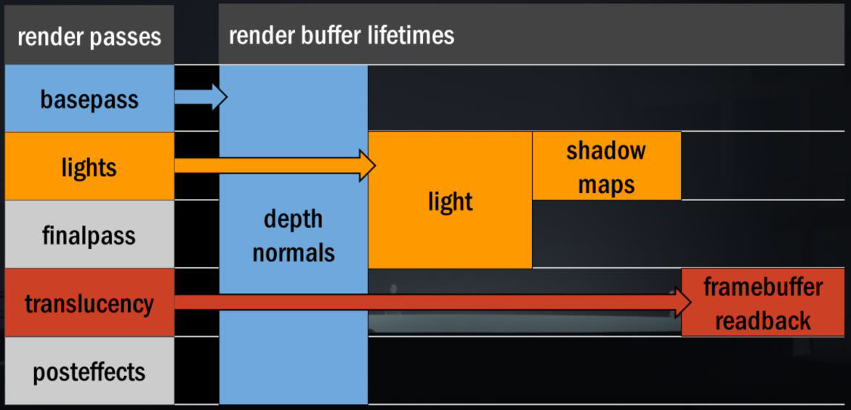
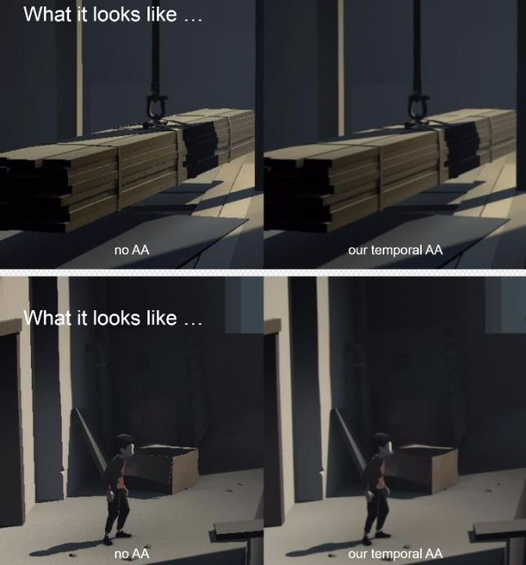
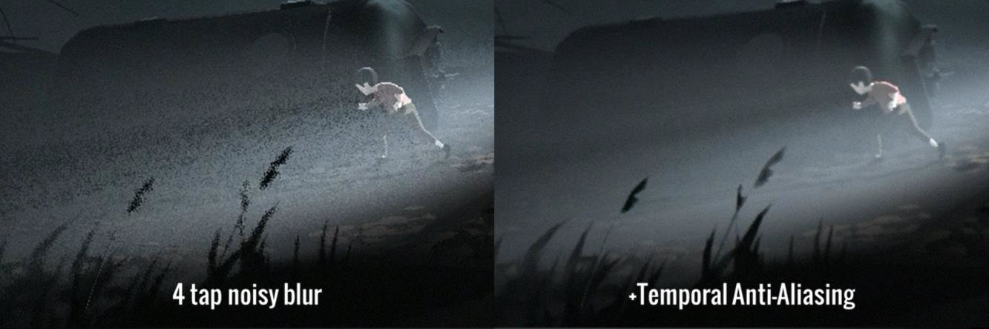
RENDERING PIPELINE
Notes:
Legacy Deferred Lighting Rendering Path is the rendering pipeline that Playdead used in Inside. It is also called light pre-pass.
Although light pre-pass is very fast and supports older platforms, it does not support many of the most recent pipelines as for example Deferred shading.
Overall this rendering pipeline fits Playdead well as it achieves what they want, which is a 60 FPS at 1080 resolution on all platforms.
Now the way they do it is by heavily modifying the individual components of the rendering pipeline.
Light pre-pass rendering consists of three main stages.
Firstly, during the base pass objects are rendered to produce screen-space buffers with depth, normal, and specular power.
Secondly, during the lighting pass the previously generated buffers are used to compute lighting into another screen-space buffer.
Finally, during the final pass objects are rendered again. They fetch the computed lighting, combine it with colour textures and add any ambient/emissive lighting.
Now, post effects are also rendered at the end of the final stage. During that process, Temporal Anti-aliasing is applied.
TAA allowed Playdead to significantly optimise performance and visuals of the game in two ways.
Firstly, TAA gave the game more dynamicity as TAA gives the effect of trailing to dynamic objects, and in Inside, the screen is never static.
Secondly, the TAA is very good at the smoothing noisy surfaces by considering the colour values of neighbouring pixels. For example in Inside Volumetric light originally required 32 samples however after applying noise and TAA the samples got reduced to 4 and the overall esthetical and performance qualities were increased. Additionally, the excessive use of dithering on everything is smoothed by TAA as well making the world more natural and less flat and polygonal.
4

Slide 5

QUESTIONS ?
References: http://www.gdcvault.com/play/1023002/Low-Complexity-High-Fidelity-INSIDE
http://www.gdcvault.com/play/1023783/Low-Complexity-High-Fidelity-INSIDE
http://www.gdcvault.com/play/1022970/Temporal-Reprojection-Anti-Aliasing-in
https://docs.unity3d.com/Manual/RenderTech-DeferredLighting.html
https://github.com/playdeadgames/temporal
Notes:
5

